Slide 1
2018 Chicago CROP hunger Walk October 14, 2018 - 2:15 Step off from 2nd PRESBYTERIAN of Chicago
Recruiter Rally

Slide 2
The need is great
Over 1 billion people in the world are hungry
... 1 out of every 7 people
Almost 16,000 children die from hunger-related causes every day
... 1 every 5 seconds
Nearly 260,000 people died during the famine that hit Somalia from 2010 to 2012
… half of them were children under the age of five,
Today, 20 million people in South Sudan, Somalia, Yemen and Nigeria are on the brink of famine
… 10 million of them are children, at risk of starvation

Slide 3
Is America hungry?
36.2 million Americans depend on assistance from food pantries and local resources
... enough to stretch from NY to LA and back ... TWICE
Notes:
Video is to give a context for the state of hunger in America
Video produced by the Feeding America organization
Click Play Button to start video – length is 3’ 30”
Possible questions after video – allow 2 minutes for a few responses
What surprised you about the video?
Did you learn anything new?

Slide 4
Is Chicago hungry?
According to the Greater Chicago Food Depository:
Every year, 1 in 6 of our neighbors (812,100 people) receives food from one of the Food Depository’s member agency grocery or meal programs
More than 232,100 households are served annually by the Food Depository
54 % of client households have annual incomes of $10,000 or less
Three faces of hunger
Families …. Elderly citizens… Youth
Notes:
Stress that we are moving from the national picture to the local picture
Additional facts:
68 % of programs reported an increase in volume of clients over the last 12 months
69 % of client households have incomes that fall at or below the federal poverty level
58 % of households served through the Food Depository network are currently receiving Supplemental Nutrition Assistance Program (SNAP) benefits

Slide 5
We Need YOU!
The need is great!
CROP Hunger Walks make a difference
Communities Responding to Overcome Poverty
Involve 2,000 communities across the country
Raised more than $294 million over the last 20 years
CROP Walks are special
The original and “granddaddy” of charity walks
Interfaith, community—based initiatives
Raise awareness and funds
Support international relief and development, as well as local hunger-fighting effort
YOU can make a difference
$75 – enables 3 women to attend literacy class for a year
$110 – provides month of emergency food supplies for a family of 5
$140 – gives a struggling farm family a new source of income: a pair of pigs
$350 – enables a child-headed household of AIDS orphans to receive vocational training
$1,050 – supports community-based health, hygiene and sanitation training
Notes:
CROP grew out of the fields of middle America. It was born in 1947, in response to the needs of hungry and suffering people in post-War Europe and Asia. U.S. Christians wanted to help their overseas neighbors in need.
CROP's original mission was to collect food commodities -- primarily grain -- and ship them overseas.
On October 17, 1969, a thousand people in Bismarck, ND, walked in what may have been the first-ever CROP Hunger Walk--and raised $25,000 to help stop hunger. Several other CROP Hunger Walks occurred soon thereafter, and before long there were hundreds of CROP Hunger Walks each year in communities nationwide. With its inception in 1969, CROP Hunger Walks are "viewed by many as the granddaddy of charity walks." (Los Angeles Times (Oct. 26, 2009).
CROP Hunger Walks help children and families worldwide – including here in the U.S. – to have food for today, while building for a better tomorrow. Each year nearly 2 million CROP Walkers, volunteers and sponsors put their caring into action, raising funds to help end hunger and poverty at home and around the world

Slide 6
Why we walk
To raise awareness
Hungry people in developing countries typically walk 6 miles a day to get food, water and fuel, and to take their goods to market
We walk in solidarity with their struggle for existence
The Chicago CROP Hunger Walk is one of the few 10K (6.2 mile) walks in the country to re-enact the walk millions must make each day for basic water and food. We truly want to "walk in their footsteps" and share their journey. The walk requires extra effort and time, but we want to "walk the walk" for one day and raise awareness to their suffering and sacrifice in a world of mercy and plenty. In addition to the 10 K route along the lake front, there is a family-friendly 2 mile walk for those with shorter legs or time constraints.
We walk because they walk!
To raise funds
Last year's walk raised a little over $45,000 to support Church World Service programs across the globe, as well as four Chicago-based agencies:
A Just Harvest
The Episcopal Hunger Committee
Lakeview Pantry
Second Presbyterian
South Loop Campus Ministry
This year’s funds will bring our 36 year total to over $1.7 million
To address the root causes of hunger at home and abroad

Slide 7
we walk … to fund global programs
CWS/CROP Walk’s roots are in feeding the hungry. Our future is in ensuring sustainable access to proper, nutritious food. How?!
A community garden? Training on feeding infants healthy food? The truth is, no single effort will eradicate hunger. In some areas, agricultural solutions can help families grow healthier food. Yet in reality most of the world’s poor buy their food, which prompts us to look deeper at the root causes of hunger. Sometimes a clean water source will help. Other times discrimination blocks access to employment, meaning a small business grant or loan in the short term can help a whole family eat for years.
ADVOCACY
Addressing the policies and prejudices that keep the world’s vulnerable in poverty
EMERGENCIES
Providing immediate and long term help in crises
Disaster Preparedness
Immediate Response
Long-Term Recovery
GLOBAL DEVELOPMENT
Helping communities to access to food, water and address other challenges
Community Development
Food Security
Water
Women & Children
REFUGEES AND IMMIGRANTS
Accompanying those who are searching for a safer, more secure home
Notes:
HUNGER AND MALNUTRITION
Food security occurs when people have consistent access to sufficient safe and nutritious food to maintain a healthy and active life.
EMERGENCIES
CWS provides assistance to communities impacted by disaster – and stays for the long term to ensure that vulnerable persons recover and are prepared for the future.
REFUGEES
More than 15.5 million people around the world are refugees – uprooted by persecution and armed conflict.
IMMIGRATION
A growing number of CWS offices and affiliates provide immigration legal services, including assistance with travel documents, petitions for family members and more.
CHILDREN
Children are precious. Malnutrition lead to nearly half of all childhood deaths before age 5. The first 1,000 days of a child's life are especially important, as they're the most vulnerable to malnutrition, unsafe water and other threats.
WATER
More than one billion people lack access to safe water – and more than 2.1 million of them die each year from waterborne diseases.
REFUGEES
More than 15.5 million people around the world are refugees – uprooted by persecution and armed conflict.
IMMIGRATION
A growing number of CWS offices and affiliates provide immigration legal services, including assistance with travel documents, petitions for family members and more.
CHILDREN
Children are precious. Malnutrition lead to nearly half of all childhood deaths before age 5. The first 1,000 days of a child's life are especially important, as they're the most vulnerable to malnutrition, unsafe water and other threats.
WATER
More than one billion people lack access to safe water – and more than 2.1 million of them die each year from waterborne diseases.

Slide 8
we walk … to support Local agencies
A Just Harvest – http://www.ajustharvest.org
A Just Harvest is a resource to people in need 365 days a year. In 2007, prior to the recession, they served 39,439 meals and distributed 100,000 pounds of food. Last year, they served over 54,000 meals. Their Community Kitchen is the largest and only self-standing community soup kitchen in the Chicago metro area. It serves hot, nutritious meals to anyone in need and hosts the Greater Chicago Food Depository’s Producemobile, which distributes several thousand pounds of fruit and vegetables to more than 200 families. In addition to feeding hungry people, A Just Harvest feeds our common hunger for hope, for fellowship, and for community. It feeds people’s hunger to serve, to improve our communities, to be creative, and to be powerful agents for justice. A Just Harvest recently made a commitment to addressing the root causes of hunger and poverty – via Northside P.O.W.E.R.’s community organizing and The Genesis Project’s economic development initiatives – while continuing to meet people’s immediate need for food.
The Episcopal Hunger Committee – http://www.episcopalchicago.org/at-work-in-the-world/hunger
The Episcopal Hunger Committee distributes grants to hunger ministries affiliated with our diocese’s congregations in Chicago: food pantries, hot meal programs, and similar food ministries. Examples of the programs they support include the Church of the Advent Saturday Lunch Program, Ravenswood Community Services, and St. James Cathedral Just Meals Ministry.
Notes:
A Just Harvest is known for being a resource to people in need 365 days a year. This constant presence is especially important during times of recession. In 2007, just prior to the recession, we served 39,439 meals and distributed 100,000 pounds of food. In 2012, we served 54,339 meals and distributed 296,000 pounds of food.
Our Community Kitchen is the largest and only self-standing community soup kitchen in the Chicago metro area. We serve hot, nutritious meals 365 days per year to anyone in need. Last year, the Community Kitchen served more than 54,000 meals.
The Community Kitchen also distributes several thousand pounds of food each month by hosting the Greater Chicago Food Depository’s Producemobile, which distributes fruit and vegetables to more than 200 families.
Anyone in need is welcome. We do not require referrals or identification. The Community Kitchen is a welcoming place for children and families.
We feed hungry people, but we also feed our common hunger for hope, for fellowship, and for community. We feed people’s hunger to serve, to improve our communities, to be creative, and to be powerful agents for justice.
More recently, A Just Harvest made a commitment to addressing the root causes of hunger and poverty – via Northside P.O.W.E.R.’s community organizing (in 2004) and The Genesis Project’s economic development initiatives (in 2010) – while continuing to meet people’s immediate need for food.

Slide 9
we walk … to support Local agencies
Lakeview Pantry – http://www.lakeviewpantry.org
Lakeview Pantry’s main “business” is distributing food to neighbors in need. The Pantry distributed more than 1.6 million pounds of food in 2016 through its two service sites and Home Delivery program and recently expanded its services boundaries northward, given the great need and lack of resources in the Uptown neighborhood. Their Social Services program provides case management, client-centered events and a newly launched mental health counseling program.
Second Presbyterian Church of Chicago – http://www.2ndpresbyterian.org
The Lunch Bag Program at Second Presbyterian serves lunches to approximately 70 people each day, Tuesday through Friday, or over 14,000 lunches each year. Their guests include both homeless, as well as individuals and families struggling to make ends meet. Located in the South Loop, the Second Presbyterian Church of Chicago is a multi-cultural community of faith, celebrating its 175th anniversary this year, and the Chicago CROP Hunger Walk is thrilled to be holding its historic 35th Walk at this historic site.
Notes:
A Just Harvest is known for being a resource to people in need 365 days a year. This constant presence is especially important during times of recession. In 2007, just prior to the recession, we served 39,439 meals and distributed 100,000 pounds of food. In 2012, we served 54,339 meals and distributed 296,000 pounds of food.
Our Community Kitchen is the largest and only self-standing community soup kitchen in the Chicago metro area. We serve hot, nutritious meals 365 days per year to anyone in need. Last year, the Community Kitchen served more than 54,000 meals.
The Community Kitchen also distributes several thousand pounds of food each month by hosting the Greater Chicago Food Depository’s Producemobile, which distributes fruit and vegetables to more than 200 families.
Anyone in need is welcome. We do not require referrals or identification. The Community Kitchen is a welcoming place for children and families.
We feed hungry people, but we also feed our common hunger for hope, for fellowship, and for community. We feed people’s hunger to serve, to improve our communities, to be creative, and to be powerful agents for justice.
More recently, A Just Harvest made a commitment to addressing the root causes of hunger and poverty – via Northside P.O.W.E.R.’s community organizing (in 2004) and The Genesis Project’s economic development initiatives (in 2010) – while continuing to meet people’s immediate need for food.

Slide 10
we walk … to support Local agencies
South Loop Campus Ministry – http://southloopcampusministry.org
The South Loop Campus Ministry helps students explore their own faith and their own spirituality. As they explore and grow into their own faith, students seek connection with traditions that stretch beyond their own, immediate experience. Each month students and friends of South Loop Campus Ministry prepare and serve a community meal at Grace Place (637 S Dearborn); volunteers donate and/or serve food and enjoy a meal with our homeless brothers and sisters. Then on Sundays, they prepare 60 meals and take it to the streets to deliver sandwiches to their homeless friends in the South Loop.
Notes:
A Just Harvest is known for being a resource to people in need 365 days a year. This constant presence is especially important during times of recession. In 2007, just prior to the recession, we served 39,439 meals and distributed 100,000 pounds of food. In 2012, we served 54,339 meals and distributed 296,000 pounds of food.
Our Community Kitchen is the largest and only self-standing community soup kitchen in the Chicago metro area. We serve hot, nutritious meals 365 days per year to anyone in need. Last year, the Community Kitchen served more than 54,000 meals.
The Community Kitchen also distributes several thousand pounds of food each month by hosting the Greater Chicago Food Depository’s Producemobile, which distributes fruit and vegetables to more than 200 families.
Anyone in need is welcome. We do not require referrals or identification. The Community Kitchen is a welcoming place for children and families.
We feed hungry people, but we also feed our common hunger for hope, for fellowship, and for community. We feed people’s hunger to serve, to improve our communities, to be creative, and to be powerful agents for justice.
More recently, A Just Harvest made a commitment to addressing the root causes of hunger and poverty – via Northside P.O.W.E.R.’s community organizing (in 2004) and The Genesis Project’s economic development initiatives (in 2010) – while continuing to meet people’s immediate need for food.

Slide 11
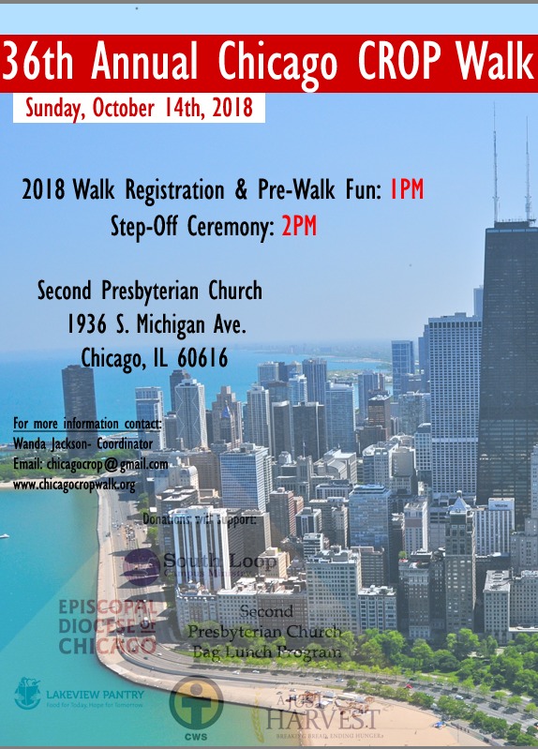
2018 Chicago CROP hunger Walk - Details
Sunday, October 14, 2018
1:00 Registration
2:00 Step-Off Ceremony
4:30 Welcome Back
Second Presbyterian Church 1936 Michigan Avenue Chicago, IL 60613
Free Parking at Ada S. McKinley,
1815 S. Wabash
Two Walk Options
10K Lakefront Route
Golden Mile Family-Friendly Route

Slide 12
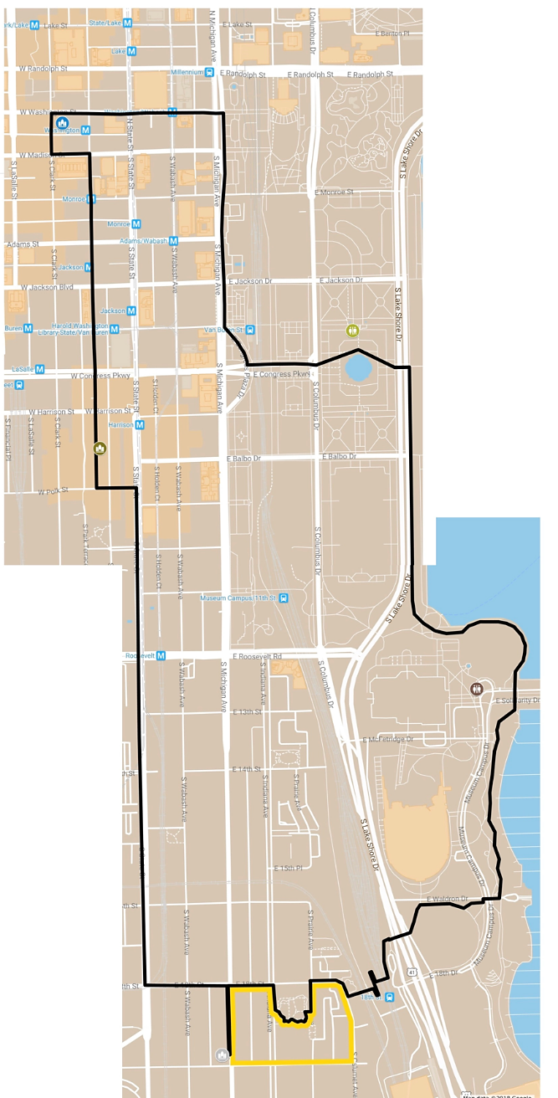
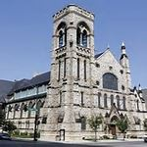
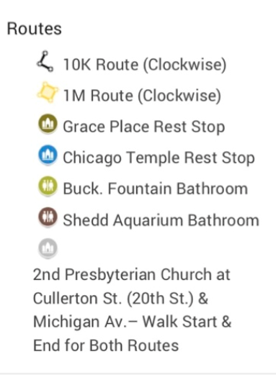
2018 Chicago crop hunger walk - route
Washington
(*) Start/Finish
2nd Presbyterian Church of Chicago
1936 Michigan Avenue Chicago, IL 60613
Free Parking at Ada S. McKinley,
1815 S. Wabash
Dearborn
Congress
State
LSD
18th Street
*

Slide 13
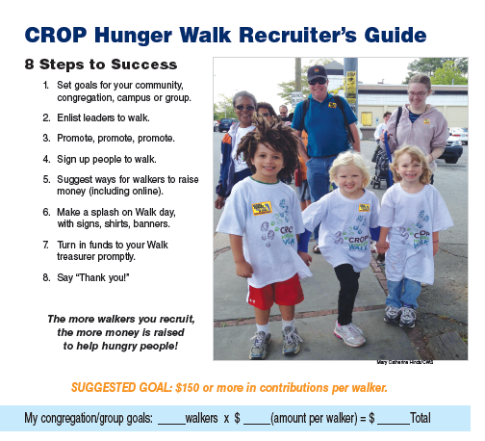
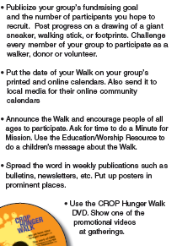
8 steps to success
Promoting the Walk

Slide 14
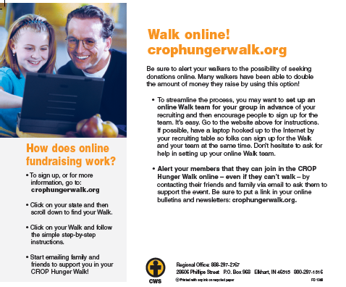
Walk on the web
Go to:
www.crophungerwalk.org/ChicagoIL
www.crophungerwalk.org/ChicagoIL
Set up your personal page
Add contacts
Customize or use the standard templates
Use your recruiting materials for ideas and content
Begin e-mailing a couple of weeks in advance
Don’t be afraid to ask … multiple times
Thank your sponsors
Let everyone know how you did
Go to ChicagoCROPWalk.org and click on Resources to see an on-line video demonstration

Slide 15
Sample communication plan
Sunday/Worship Service
September 2 – Announce the walk and call for Walkers; set up table with CROP walk information. Talk to Youth Group leaders, Confirmation Class, Sunday School teachers
September 9 – Repeat call and share goals; set up table with CROP walk information
September 16– Mission moment: skit or reading from recruiting materials
September 23 – Bulletin insert and CROP coins/spare change project
September 30 – Mission moment and progress announcement; call for walkers
October 7 – Mission moment and bulletin insert
October 14 – WALK DAY! Include Walk liturgy in Worship Service; pass around envelope/collection plate for 2nd mile / team effort
Walk On-Line
2 Months before Walk – invite potential Team members to sign up
6-7 weeks before the Walk – send a second invitation/thank you message to team
4 weeks before the Walk – send first batch of e-mails to potential sponsors asking for support
3 weeks before the Walk – begin adding to your contact list and communicate with them
AS DONATIONS COME IN – thank your sponsors for their support
2 weeks before the Walk – send second message to anyone on contact list who hasn’t responded
1 week before the Walk – send message to the entire list thanking them for support and reporting on your progress
3 days before the Walk – send It’s Not Too Late message to anyone on contact list who hasn’t responded
Day after the Walk – send Thank You for your Support message to everyone on the list, informing them of your results and inviting any second mile or last minute donations

Slide 16
Before & After the walk
Have each walker complete a registration form
Encourage your walkers to collect funds in advance of the Walk
Have walkers turn in funds after church on Walk Day
Count and verify funds ... Share the results
Make arrangements to collect any outstanding funds
Store funds in a safe place until they can be deposited
Follow instructions to submit funds
Mail or drop off your team’s contributions
Complete a financial statement each time you turn in funds
Convert cash into a check or money order prior to mailing
Note all donation envelope #’s on the memo line of the check
Contact the Chicago CROP Walk Treasurer, Sara Trumm, with any questions at strumm@lstc.edu.

Slide 17
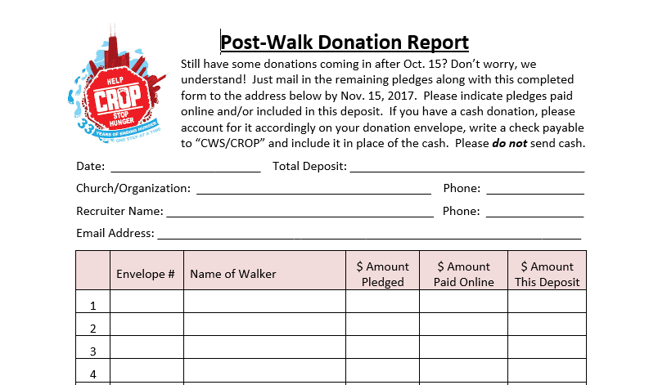
Financial Instructions
The total and date for this deposit
$,$$$.$$
Fill in your contact information
IMPORTANT!!
The # on their packet
Include each walker’s name
Individual $$ in this deposit
$,$$$.$$

Slide 18
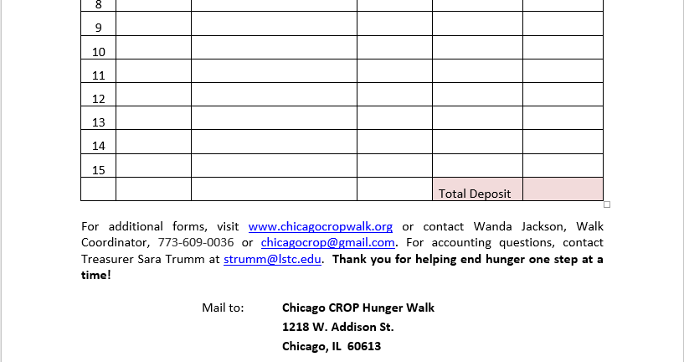
Financial Instructions
Add up everything
$,$$$.$$

Slide 19
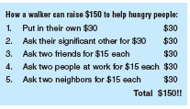
Questions & Next Steps
Can we count on you?
Help us make history: 35 years!
Sign up on line
Or ask for materials now …
THANK YOU!!
For more information, contact Gail Angel at Gail.Angel@fisglobal.com or Avanteangel@aol.com, 773 907-8595

Slide 20
Appendix Faces of Hunger global programs national demographics cws financials

Slide 21
Faces of hunger: families
61 percent of the working poor experienced some level of food insecurity in the last year
22 percent had used a pantry within the past year
49 percent report three or more food insecure conditions in their household … they
Lacked money for food
Lacked money to maintain a balanced diet
Cut meal sizes or skipped meals to stretch the food they had
Or went hungry
40% of the working poor who need food assistance, but are not using a pantry, believe that “people will look down on you if they know you use a food pantry”
Notes:
Discuss the key findings as they relate to family in the video
Additional facts:
70 percent have children under age 18 in the household
Individuals reported they were more likely to turn to family than a food pantry when in need of food assistance
Among the working poor who have never used a pantry, 35 percent stated “lack of information about the program or location” as a reason for not using a pantry

Slide 22
Faces of hunger: the Elderly
72% of older adults are at “high nutritional risk;” only 5% of are at “low nutritional risk”
Access to healthy food is especially important for older adults. Most in this study had high blood pressure and a significant number had diabetes
92% of those surveyed who didn’t have money to buy food had access to food assistance programs
Low-income older adults in Cook County often skip meals, eat less often, eat smaller meals, or eat food they know is bad for their health; in some cases, they go without a meal for a full day
Notes:
Discuss the above key findings as they relate to Marjorie
Additional Facts
Almost a third of those interviewed were unable to obtain food at some point even though they could afford food. The most common reason cited: an illness or physical limitation, especially when the individual lived alone
The weight of food is also a problem for older adults. Some reported being unable to carry home heavy items like meat, produce, and milk, and instead bought fewer foods or lighter (weight), less nutritious foods
Almost all respondents reported a lack of access to the fresh fruits and vegetables needed for a nutritious diet

Slide 23
Faces of Hunger: youth
Hunger hurts everyone, but is especially devastating in childhood
On empty stomachs, kids don’t have energy to focus, engage, learn and grow. 1 in 5 children in the U.S. worry about when they’ll have their next meal
84% of households served report purchasing the cheapest food available to provide enough food for the household, even if it wasn’t the healthiest option
Food insecurity has been linked with delayed development, poorer attachment, and learning difficulties in the first two years of life
Children growing up in food-insecure families are vulnerable to poor health and stunted development
Pregnant women who experience food insecurity are more likely to experience birth complications and be at risk for low birth weight in babies
Notes:
Additional facts
An average food-insecure family of four may forgo up to 100 meals a month because they lack enough money to buy food

Slide 24
Advocacy … speaking out with those who are displaced or vulnerable

Slide 25
Emergency response … helping people recover and rebuild

Slide 26
Global development … Empowering families to move beyond the cycle of poverty

Slide 27
Global development - Food security

Slide 28
Refugees & immigrants … helping people find a home and feel safe

Slide 29
Who walks?
CROP Hunger Walk demographics
1300 Walks per Year
116K Participants
68% are over 18, average age is 33.5.
About two-thirds are women.
64% of CROP Hunger Walkers over age 18 have a college or advanced degree. Half are professionally employed in their communities.
Half are CROP Hunger Walking for their second, third, fourth, or more time.
73% of participants say fighting hunger locally and globally is their key reason for taking part.
53% say the CROP Hunger Walk is the only fund-raising marathon-type activity in which they participate.
Walkers get about 95% of their sponsors from their place of worship, family, neighborhood and workplace.
$12 Million Dollars Raised

Slide 30
CWS financials
Total Revenue: $96,573,865
Over 85% of funds are used for Hunger, Emergency, and Refugee programs
Only 4.6% of funds are used for administration
Church World Service is tax exempt under section 501(c)(3) of the Internal Revenue Code.
Contributions are tax deductible
CROP Walks account for roughly 29% of CWS funds
Total Expense: $94,411,147

Slide 31
On-line training
If you haven’t already signed up, click on the Register button

Slide 32
On-line training
Enter your information …

Slide 33
On-line training
Now update your personal page:
Upload a photo
Create a URL
Customize your own page description

Slide 34
On-line training
To set up your team, click on START a team

Slide 35
On-line training
Invite others to join your on-line team

Slide 36
On-line training
Update your account details

Slide 37
On-line training
You’re almost done!

Slide 38
On-line training
Make any edits to your personal page

Slide 39
On-line training
Send messages via e-mail or social media

Slide 40
On-line training
… And you’re ready to get started!

Slide 41
On-line training
Questions?
Try it out …
… send messages to yourself if you want to practice
Contact webwalk@crophungerwalk.org if you have questions
Good luck!!

